Slide 1
SQL for E-Commerce & Logistics Analytics
Practical Lab: Brazilian E-Commerce (Olist) Dataset
Tools: XAMPP (MySQL), phpMyAdmin, Google Looker Studio
ROLL NUMBERS: 202410072
202312598
202410327
202411162
202410323

Slide 2
Lab Objectives
Data Management: Import real-world CSV datasets and design relational tables/keys
Integration: Use SQL joins to integrate various business systems
Analytics: Generate business KPIs and build management dashboards
Logistics: Explain SQL's role in supporting logistics decision-making

Slide 3
Environment Setup
Required Software:
XAMPP (Apache + MySQL)
Web Browser
Data Source: Brazilian E-Commerce Dataset from Kaggle

Slide 4
Part 1 - Database Setup
Service Initialization:
Launch XAMPP Control Panel and start Apache and MySQL
Open phpMyAdmin in your browser
Initialization SQL:
CREATE DATABASE ecommerce_db;
USE ecommerce_db;

Slide 5
Part 2 & 3 - Table Creation & Data Import
Core Systems (Tables):
Customer's System
Orders System
Order Items (Logistics & Fulfillment)
Payments System
Reviews (Customer Satisfaction)
Import Process: Select table → Click Import → Choose CSV file → Click Go

Slide 6
Part 4 - Data Verification
Validation Queries: Use SELECT COUNT(*) to ensure data integrity

Slide 7
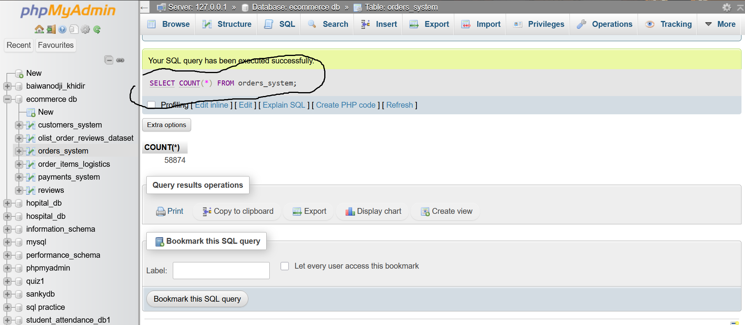
Key Table to Check: orders

Slide 8
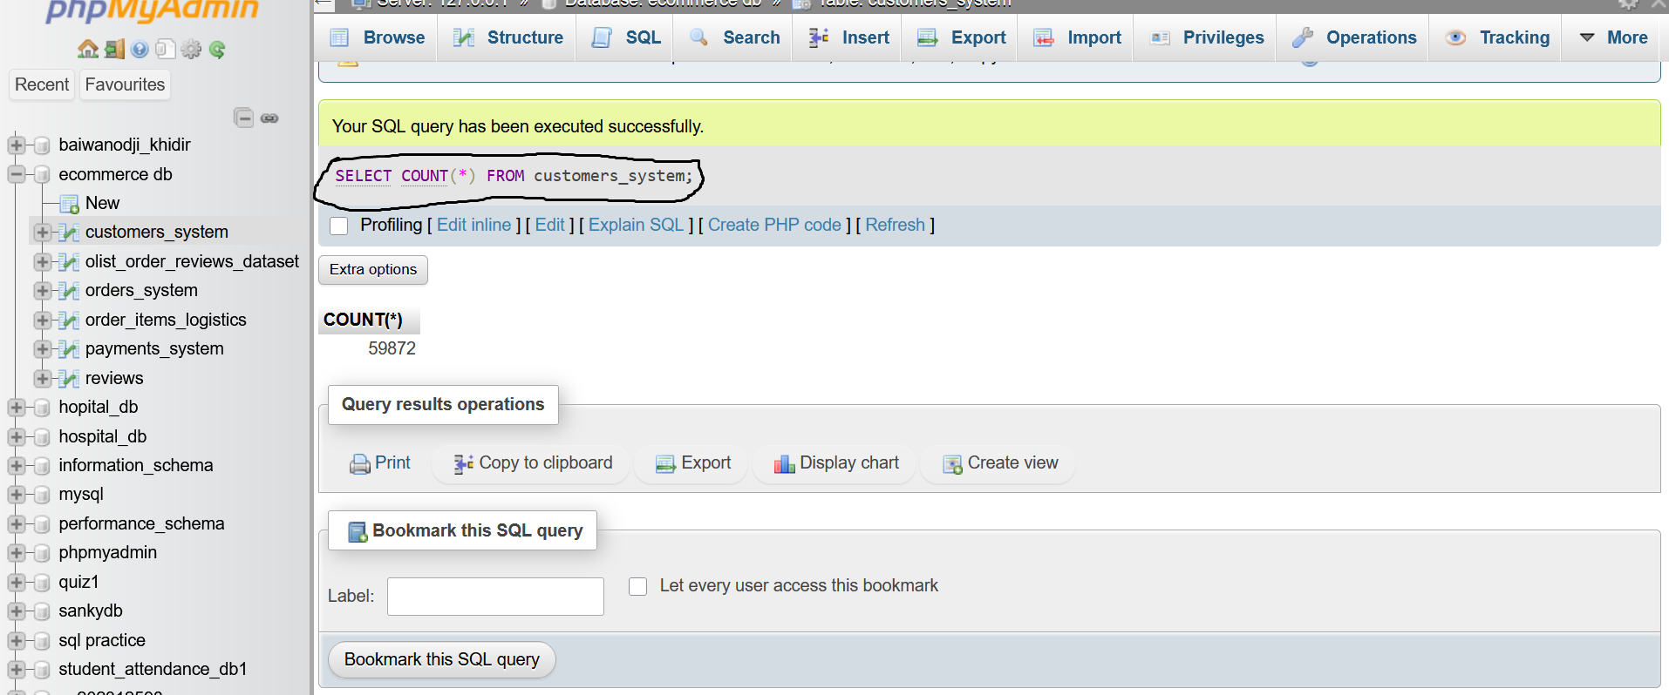
Key Table to Check: customers

Slide 9
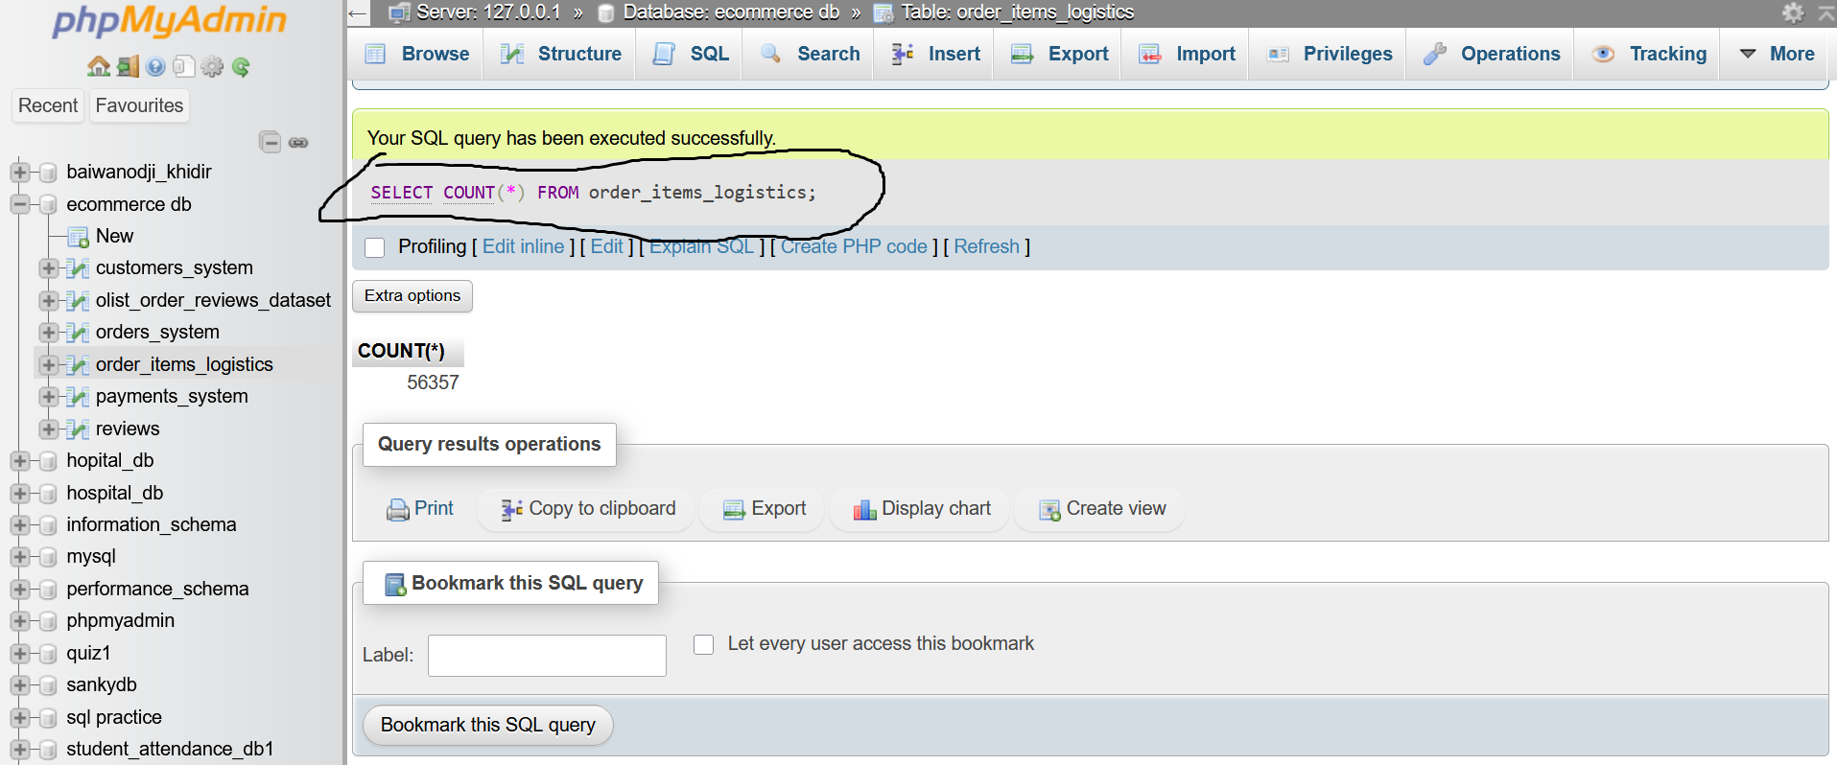
Key Table to Check: order_items

Slide 10
Part 5 - Dashboard KPIs (Business & Logistics)

Slide 11
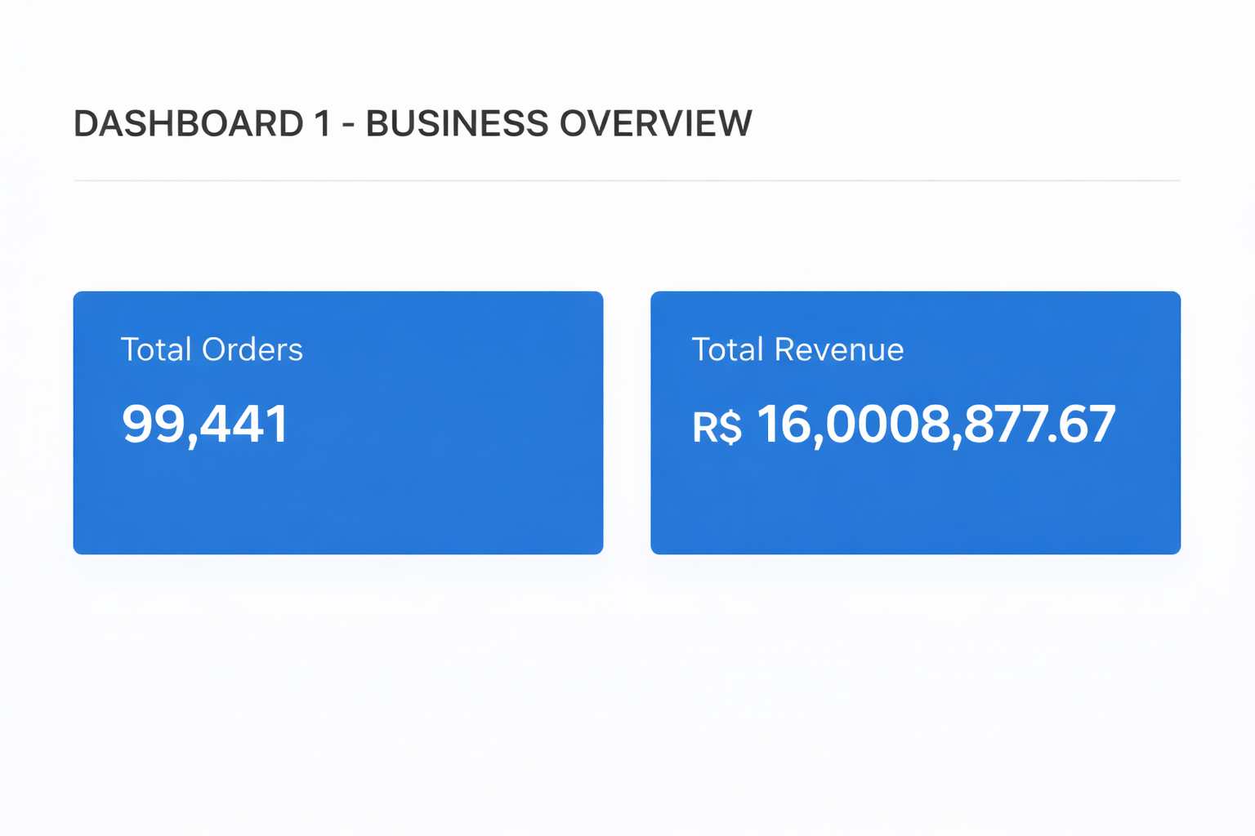
Business Overview: Total Orders and Total Revenue

Slide 12
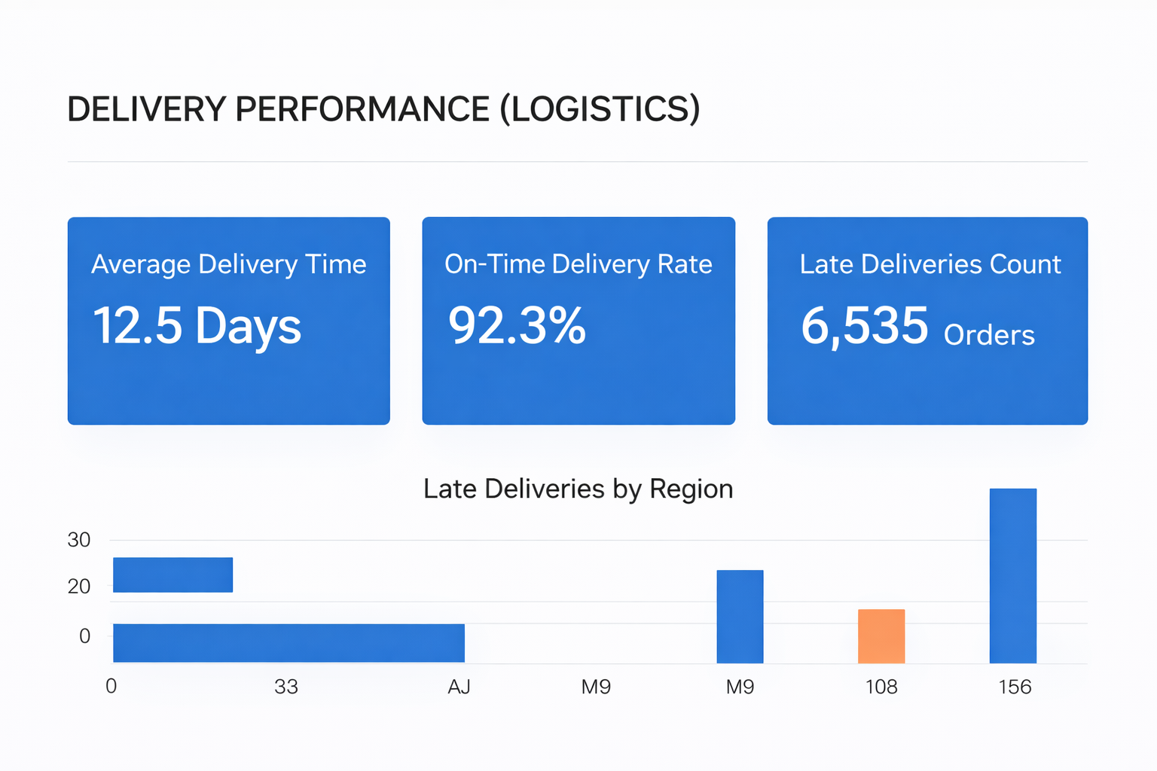
Logistics Performance: Average Delivery Time (Days) On-Time Delivery Rate vs. Late Deliveries

Slide 13
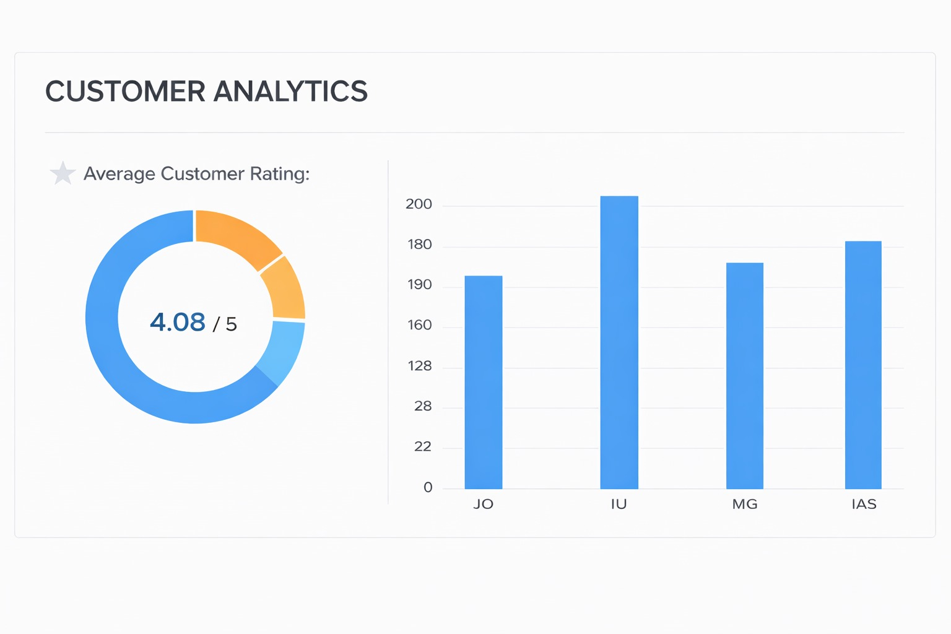
Customer & Financials:
Average Rating and Orders by Region

Slide 14
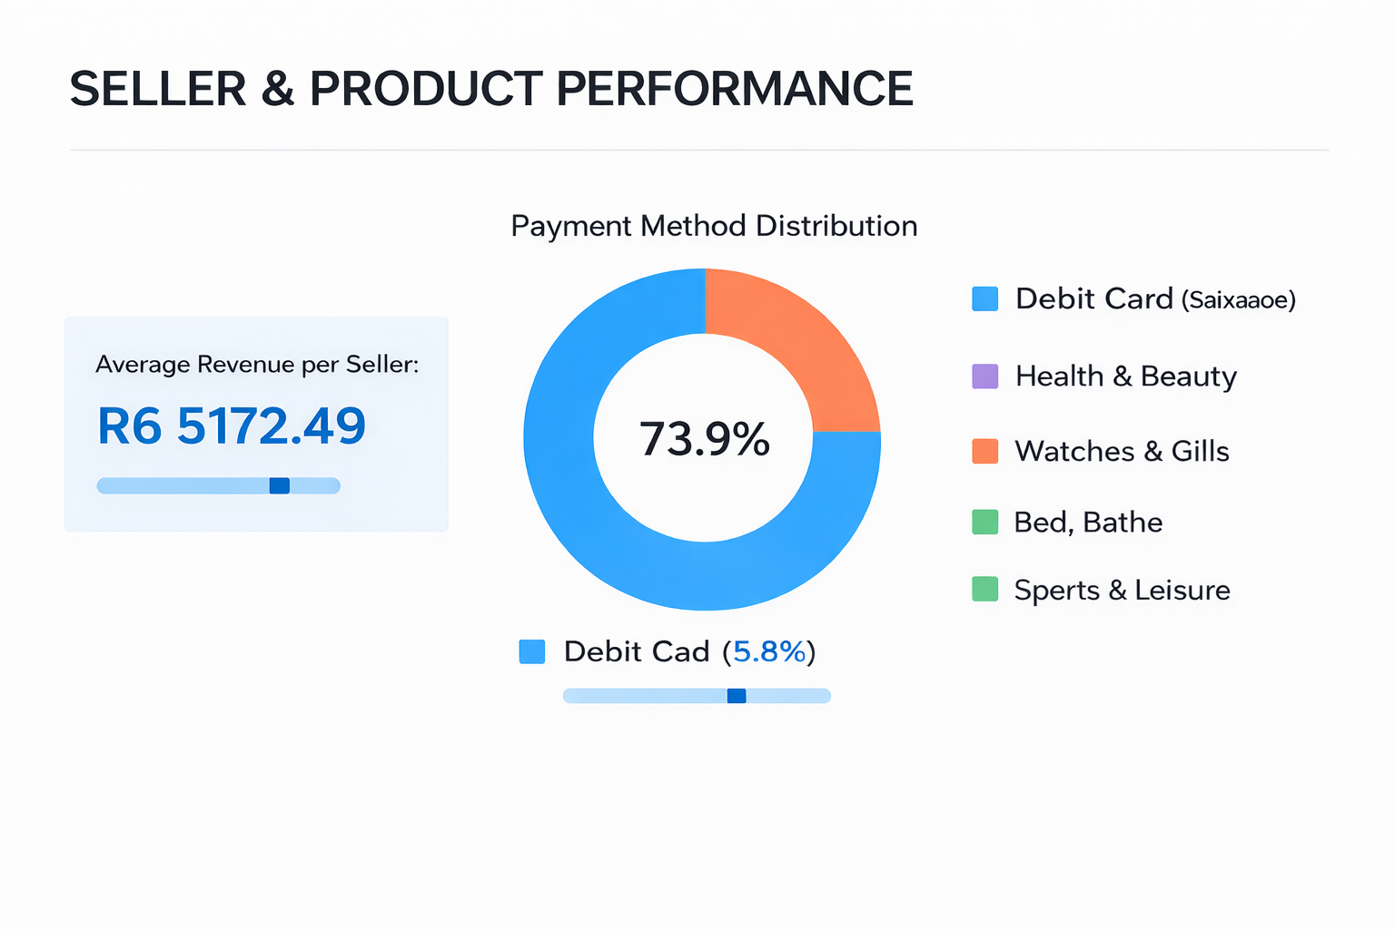
SELLER AND PRODUCT PERFORMANCE : Revenue per Seller and Top 5 Products

Slide 15
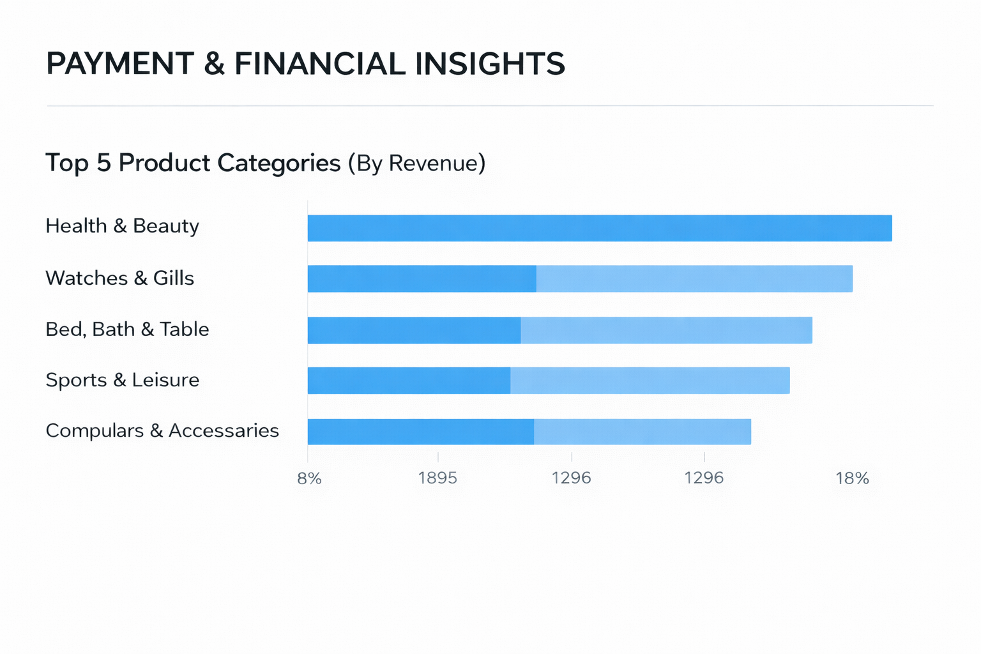
PAYEMENT AND FINANCIAL INSIGHTS : Payment Method Distribution

Slide 16
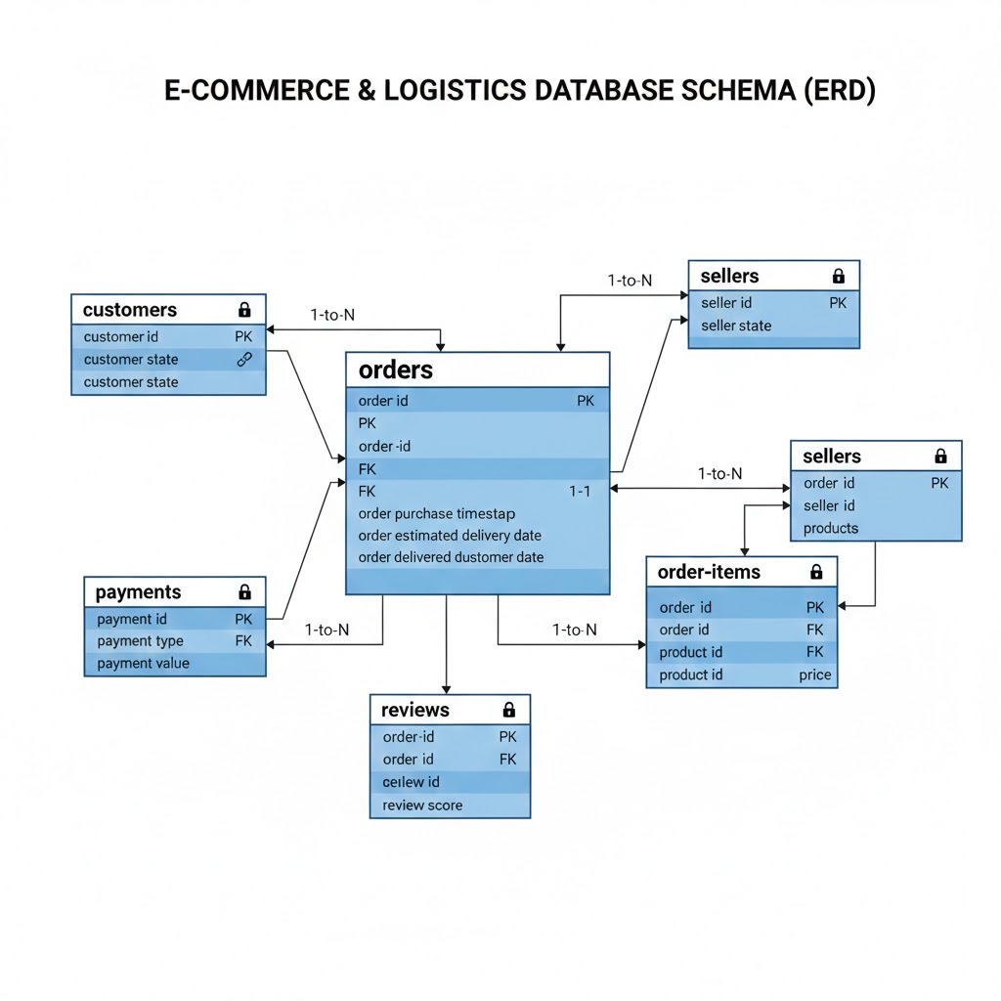
Part 6 - System Integration

Slide 17
Part 7 - Discussion & Assessment
Why is SQL critical for logistics optimization?
How does late delivery affect customer satisfaction?
Which KPI would you improve first as a manager?
How does this system reflect real DHL/FedEx operations?

